Slide 1


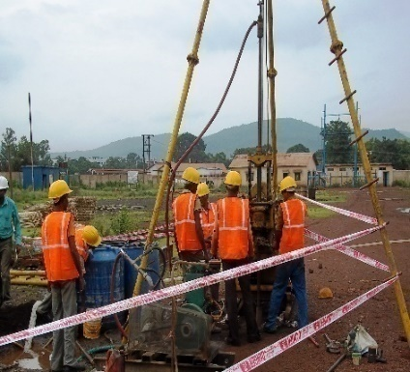
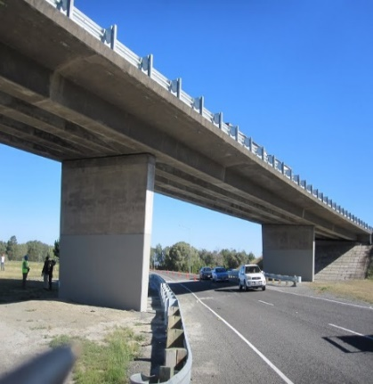
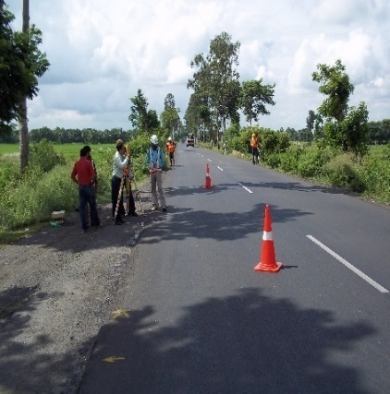
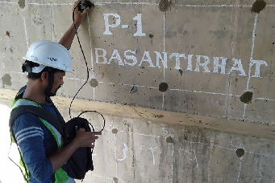


C. E. TESTING COMPANY PVT. LTD.
SERVICES OFFERED:
Geotechnical Engineering
Geophysical Testing
Highway Engineering
Railway Engineering
Bridge Design
Survey Engineering
Building Design
Water Supply Design
Non Destructive Testing
ISO Certifications
  IS/ISO 9001: 2015
  ISO 14001:2015
  ISO 45001:2018
Registered Office
124-A, N.S.C. Bose Road,
Kolkata -700092
Tel: 033 2428 6221 / 6222 / 6223
Fax: 033 2428 6220
Mail: cetest@cetestindia.com
marketing@cetestindia.com
CIN: U74920WB1988PTC045778
Web: www.cetestindia.com
Laboratory & Godown
Sardarpara, Brahmapur, Kolkata
NABL certificate no. for our
accredited Parameters: TC-6840
Project Offices
Agartala, Tripura
Patna, Bihar
Ranchi, Jharkhand
Hyderabad, Telangana
Guwahati, Assam
Imphal, Manipur
Competence | Confidence | Commitment

